Slide 1
Optimization and Prediction of Tensile Strength of an S235JR Mild Steel Weld using RSM (Response Surface Method) and Decision Tree Analysis
Engr. Seigha Gumus, FNIMechE
NACETEM South-South
NACETEM Researchers’ Seminar Series
Feburary, 2026

Slide 2
Outline
Background
Research Motivation
Problem Statement
Objectives
Research Questions
Materials and methods
Results
Conclusions

Slide 3
Background
Welding is a manufacturing process widely used in industries ranging from automotive, aerospace, construction, and pipeline manufacturing.
Welding involves the joining of materials, such as metals through the application of heat or pressure to form a cohesive bond
Welding processes inherently introduce residual stresses, which can compromise the integrity and performance of welded structures
This study applies RSM and DT to predict the tensile strength of an S235JR mild steel weld
3

Slide 4
Research Motivation
To address challenges associated with residual stress via computational techniques
Integrating RSM and Decision Tree approaches which enables researchers to optimize welding processes while accurately predicting residual stress outcomes.
Application of this hybrid approach which can significantly enhance welding quality and reliability, thereby offering solutions to long-standing challenges in welding engineering.
4

Slide 5
Problem Statement
During welding processes, residual stresses are inherent and can affect the weld quality. Without precise control over residual stress and weldments, there usually arises a complicated stress and optimization
The traditional experiment and analytical methods often fall short due to inherent limitations when predicting and controlling residual stress
5

Slide 6
Objectives
Investigate influence of welding parameters on tensile strength
Develop predictive and optimization models for tensile strength
Apply RSM and DT to optimize welding parameters for tensile strength
Validate predictions by compare the predicted results with the actual result
6

Slide 7
Materials and Methods
Experimental Set-up
  Base Material: S235JR Mild Steel
  Welding Operation: Tungsten Inert Gas (TIG) Welding
The Method Outline;
  Data Collection
  Model Building
  Model Analysis
  Analysis of variance (ANOVA)
  The Decision Tree (DT) Analysis
7

Slide 8
Data Collection
Data collection focused on four key input parameters: Voltage (V), Current (A), Gas Flow Rate (L/min), and Ambient Temperature (°C), which were varied systematically
TABLE 1: WELDING PARAMETERS
Parameters | Value
 | Low | High
Current (A) | 190 | 220
Voltage (V) | 21 | 24
Gas flow rate (L/min) | 13 | 16
Material Temperature (⁰C) | 28 | 38

Slide 9
Model Building
Experimental results were obtained for tensile strength using the universal testing machine so that a second –order polynomial regression model for the tensile strength was developed
Model Analysis
The RSM and DT were used to comprehensively assessed the relationship between the welding input parameters and the tensile strength response variables using various statistical and graphical tools.
9

Slide 10
Analysis of Variance ANOVA
ANOVA evaluated the significance of each input factor and their interactions, while the fit statistics provided insights into model precision and reliability and AHP validated the mode.
Decision Tree(DT)
DT algorithm was evaluated for estimating key response variables based on the input factors. The performance and reliability of the DT model were examined through a series of graphical diagnostics and visualizations, including the decision tree graph (to visualize model structure), predictor importance plot (to identify the most influential variables), and 3D surface plots (to understand factor-response relationships)

Slide 11
Result
Twenty (20) experimental runs were carried out using Tungsten Inert Gas (TIG) welding process focusing on Current (A), Voltage (V), Gas flow rate (L/min) and Ambient Temperature (⁰C)
Results showed that Tensile Strength varies significantly with changes in input parameters.
TABLE 2: EXPERIMENTAL RESULTS WITH 20 RUNS
Std | Run | Factor 1 A: Current | Factor 2 B: Voltage | Factor 3 C: Gas Flow Rate | Factor 4 D: Ambient Temp | Response 1 Tensile Strength (MPa)
5 | 1 | 200 | 22 | 14 | 30 | 516
11 | 2 | 200 | 22 | 14 | 30 | 517
8 | 3 | 200 | 22 | 14 | 32 | 525
18 | 4 | 200 | 22 | 14 | 31 | 516
2 | 5 | 200 | 22 | 14 | 32 | 521
6 | 6 | 210 | 23 | 15 | 33 | 508
9 | 7 | 210 | 21 | 15 | 34 | 480
12 | 8 | 210 | 24 | 15 | 36 | 467
3 | 9 | 190 | 23 | 15 | 28 | 565
4 | 10 | 220 | 23 | 15 | 34 | 517
20 | 11 | 210 | 23 | 13 | 35 | 487
10 | 12 | 210 | 23 | 16 | 37 | 509
16 | 13 | 190 | 21 | 13 | 29 | 531
15 | 14 | 190 | 24 | 13 | 35 | 488
14 | 15 | 220 | 21 | 13 | 28 | 522
13 | 16 | 220 | 24 | 13 | 38 | 428
1 | 17 | 190 | 21 | 16 | 34 | 502
19 | 18 | 190 | 24 | 16 | 30 | 553
7 | 19 | 220 | 21 | 16 | 37 | 477
17 | 20 | 220 | 24 | 16 | 38 | 484
11

Slide 12
RSM ANALYSIS
The RSM analysis in this study comprehensively assessed the relationship between the welding input parameters and the response variables using various statistical and graphical tools. the tables below show the fit summary, lack of fit test and analysis of variance.

Slide 13
TABLE 3: Fit Summary for Tensile strength
Source | Model p-value | Lack of Fit p-value | Adjusted R² | Predicted R²
Design Model | < 0.0001 | 0.0568 | 0.9495 | 0.7967
Linear | < 0.0001 | 0.0225 | 0.8604 | 0.7782
2FI | 0.4866 | 0.0202 | 0.8596 | 0.3472
Quadratic | < 0.0001 | 0.8732 | 0.9980 | 0.9528 | Suggested
Cubic | 0.8732 |  | 0.9963 |  | Aliased

Slide 14
TABLE 4: Lack of Fit Tests for Tensile strength
Source | Sum of Squares | df | Mean Square | F-value | p-value
Linear | 2918.42 | 13 | 224.49 | 52.82 | 0.0187
2FI | 1609.65 | 7 | 229.95 | 54.11 | 0.0183
Quadratic | 10.31 | 3 | 3.44 | 0.8088 | 0.5941 | Suggested
Cubic | 0.0000 | 0 |  |  |  | Aliased
Pure Error | 8.50 | 2 | 4.25
Table 4 presents the lack of fit test results for the tensile strength model, providing critical insight into the adequacy of the different model forms. The quadratic model exhibits the most desirable statistical performance, with a very low sum of squares (10.31), low mean square (3.44), and a non-significant p-value of 0.5941, indicating that the model's deviation from the actual data is not statistically significant—making it a good fit for the observed data and the suggested model for further analysis. Overall, the quadratic model provides the best fit with minimal lack of fit, justifying its use in modeling tensile strength
14

Slide 15
TABLE 5: ANOVA for Tensile Strength
Source | Sum of Squares | df | Mean Square | F-value | p-value
Model | 0.0000 | 14 | 9.251E-07 | 691.58 | < 0.0001 | significant
A-Current | 3.191E-07 | 1 | 3.191E-07 | 238.54 | < 0.0001
B-Voltage | 8.393E-09 | 1 | 8.393E-09 | 6.27 | 0.0542
C-Gas Flow Rate | 3.620E-07 | 1 | 3.620E-07 | 270.64 | < 0.0001
D-M. Temp | 1.516E-08 | 1 | 1.516E-08 | 11.33 | 0.0200
AB | 8.056E-08 | 1 | 8.056E-08 | 60.22 | 0.0006
AC | 3.381E-08 | 1 | 3.381E-08 | 25.27 | 0.0040
AD | 3.948E-08 | 1 | 3.948E-08 | 29.51 | 0.0029
BC | 1.077E-07 | 1 | 1.077E-07 | 80.49 | 0.0003
BD | 1.488E-07 | 1 | 1.488E-07 | 111.24 | 0.0001
CD | 3.095E-08 | 1 | 3.095E-08 | 23.14 | 0.0048
A² | 7.338E-08 | 1 | 7.338E-08 | 54.85 | 0.0007
B² | 2.170E-07 | 1 | 2.170E-07 | 162.21 | < 0.0001
C² | 5.566E-07 | 1 | 5.566E-07 | 416.06 | < 0.0001
D² | 4.506E-08 | 1 | 4.506E-08 | 33.69 | 0.0021
Residual | 6.688E-09 | 5 | 1.338E-09
Lack of Fit | 1.688E-09 | 3 | 5.628E-10 | 0.2251 | 0.8732 | not significant
Pure Error | 5.000E-09 | 2 | 2.500E-09
Cor Total | 0.0000 | 19
15

Slide 16
The ANOVA shows:
  Results for the tensile strength response, confirming the statistical significance of the developed quadratic model.
  Voltage and Current are the most influential factors.
  Significant main effects and interactions observed (p < 0.0001, high F-values).
  Models show excellent fit (R² > 0.99).
  This strong statistical performance justifies the use of the quadratic model for predicting and optimizing tensile strength in mild steel weldments.

Slide 17
The Model
The equation below represents the quadratic regression model for predicting Tensile Strength based on Current (A), Voltage (B), Gas Flow Rate (C), and Ambient Temperature (D).
𝑇𝑒𝑛𝑠𝑖𝑙𝑒 𝑆𝑡𝑟𝑒𝑛𝑔𝑡ℎ = 81.59620 − 54.52318 ⋅ 𝐴 + 523.17603 ⋅ 𝐵 − 273.71894 ⋅ 𝐶 +140.13279 ⋅ 𝐷 + 0.248164 ⋅ (𝐴 ⋅ 𝐵) + 0.376066 ⋅ (𝐴 ⋅ 𝐶) − 0.439288 ⋅ (𝐴 ⋅ 𝐷) + 18.34720 ⋅ (𝐵 ⋅ 𝐶) − 4.90639 ⋅ (𝐵 ⋅ 𝐷) − 2.72272 ⋅ (𝐶 ⋅ 𝐷) + 0.138175 ⋅ 𝐴² − 15.26499 ⋅ 𝐵² − 4.38190 ⋅ 𝐶² + 1.55510 ⋅ 𝐷^{2…………………………………….}eqn. 1
The model is a comprehensive representation of the factors influencing tensile strength in welding, and it Captures main effects, interaction effects (e.g., A·B, B·C), and quadratic terms (e.g., A², B²).

Slide 18
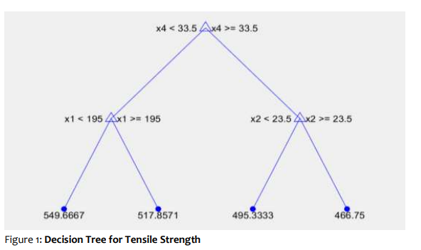
AHA Analysis
The decision tree model for predicting tensile strength, revealing a clear, interpretable structure that highlights the influence of key input variables. the root node splits based on ambient temperature (x4), demonstrating its dominant role in determining tensile strength outcomes.
18

Slide 19
Table 6: Predicted result of RSM vs Decision Tree to Experimental Results for Tensile Strength
S/N | Current (A) | Voltage (V) | Gas Flow Rate (L/min) | Ambient Temp. (°C) | EXP (MPa) | RSM (MPa) | Decision Tree (MPa)
1 | 190 | 21 | 13 | 32 | 516.00 | 516.61 | 517.85
2 | 200 | 21 | 14 | 33 | 517.00 | 516.61 | 517.85
3 | 210 | 21 | 15 | 29 | 525.00 | 521.87 | 517.85
4 | 220 | 21 | 16 | 30 | 516.00 | 517.69 | 517.85
5 | 190 | 22 | 14 | 34 | 521.00 | 521.87 | 517.85
6 | 200 | 22 | 13 | 28 | 508.00 | 506.37 | 517.85
7 | 210 | 22 | 16 | 37 | 480.00 | 480.71 | 495.33
8 | 220 | 22 | 15 | 35 | 467.00 | 467.27 | 466.75
9 | 190 | 23 | 15 | 31 | 565.00 | 565.18 | 549.66
10 | 200 | 23 | 16 | 36 | 517.00 | 517.81 | 495.33
11 | 210 | 23 | 13 | 36 | 487.00 | 487.75 | 495.33
12 | 220 | 23 | 14 | 38 | 509.00 | 509.24 | 495.33
13 | 190 | 24 | 16 | 29 | 531.00 | 530.87 | 549.66
14 | 200 | 24 | 15 | 34 | 488.00 | 488.04 | 466.75
15 | 210 | 24 | 14 | 37 | 522.00 | 521.86 | 517.85
16 | 220 | 24 | 13 | 35 | 428.00 | 427.59 | 466.75
17 | 190 | 22 | 13 | 32 | 502.00 | 502.05 | 495.33
18 | 200 | 21 | 15 | 28 | 553.00 | 552.97 | 549.66
19 | 210 | 23 | 16 | 30 | 477.00 | 476.61 | 495.33
20 | 220 | 24 | 14 | 36 | 484.00 | 484.01 | 466.75
19

Slide 20
Table 6 shows the Predicted result of RSM vs Decision Tree to Experimental Results for Tensile Strength, compares the performance of Response Surface Methodology (RSM) and a Decision Tree model in predicting tensile strength against experimental (EXP) results under varying input conditions such as Current, Voltage, Gas Flow Rate, and Ambient Temperature.
20

Slide 21
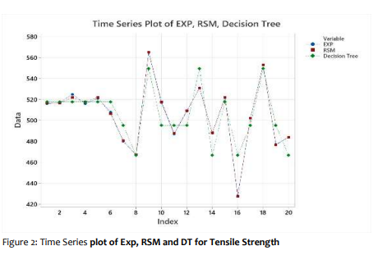

Slide 22
Figure 2 shows The Time Series Plot of EXP, RSM, and Decision Tree for Tensile Strength. it compares the experimental (EXP), Response Surface Methodology (RSM), and Decision Tree (DT) predictions over a series of data points indexed from 1 to 20.
Experimental data shows pronounced fluctuations with distinct peaks and troughs.
RSM predictions closely match experimental values, accurately capturing sharp variations and trends.
Decision Tree predictions are smoother, showing reduced sensitivity to rapid changes.
Overall, RSM demonstrates higher accuracy, while DT offers a simpler but more generalized approximation
22

Slide 23
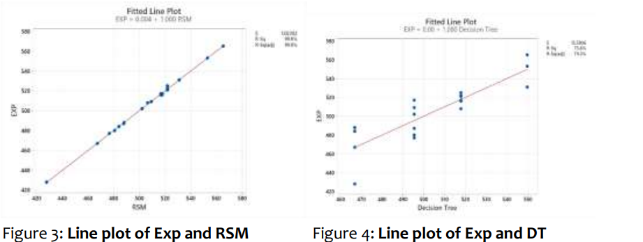
Figures 3 and 4 include a fitted line equation to quantify model accuracy.
Figure 3 (line plot of EXP vs. RSM): Shows a strong linear correlation between experimental values and RSM predictions. While,
Figure 4 (Line plot of EXP vs. Decision Tree): Displays the relationship between experimental values and DT predictions.
RSM generally aligns more closely with EXP, while DT shows greater deviations in some regions.
23

Slide 24
CONCLUSION
In conclusion, this study highlights the complementary strengths of RSM and Decision Tree models in analyzing and optimizing material responses.
The findings emphasize the importance of selecting the appropriate modeling approach based on the specific requirements of the analysis.
24

Slide 25
Recommendation
Future work could explore hybrid models that combine the strengths of both approaches, leveraging RSM's precision for detailed predictions and the Decision Tree's interpretability for broader insights.
Such an integrated strategy could enhance the robustness and applicability of predictive models in materials science and related fields.
25

Slide 26

Thank you.

